Slide 1
COT 4521: Introduction to Computational Geometry
Voronoi Diagram

Slide 2
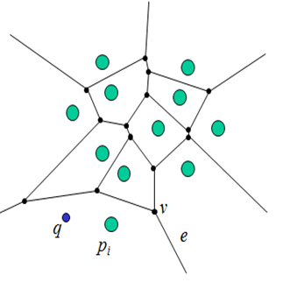
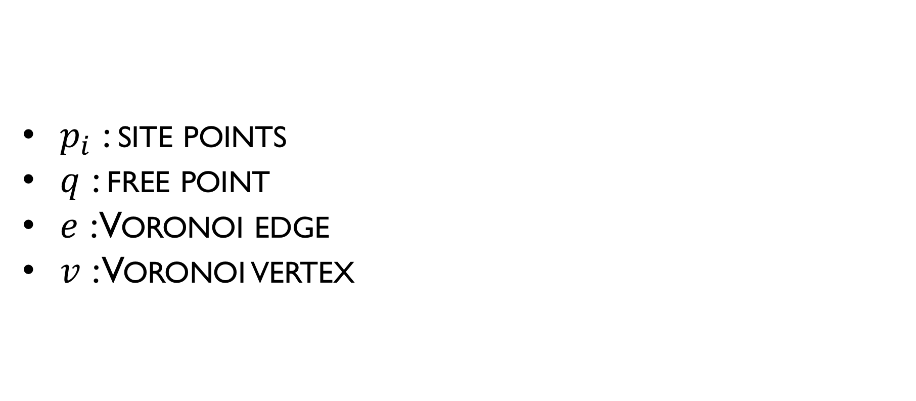
Voronoi Diagrams
$p_{i}$ : site points
$q$ : free point
$e$ : Voronoi edge
$v$ : Voronoi vertex

Slide 3
Definition of Voronoi Diagram
Demo – http://alexbeutel.com/webgl/voronoi.html

Slide 4
Voronoi Diagrams: Applications
Fire observation Towers
Facility Planning
Path Planning
Crystallography have long been used to simulate crystal growth

Slide 5
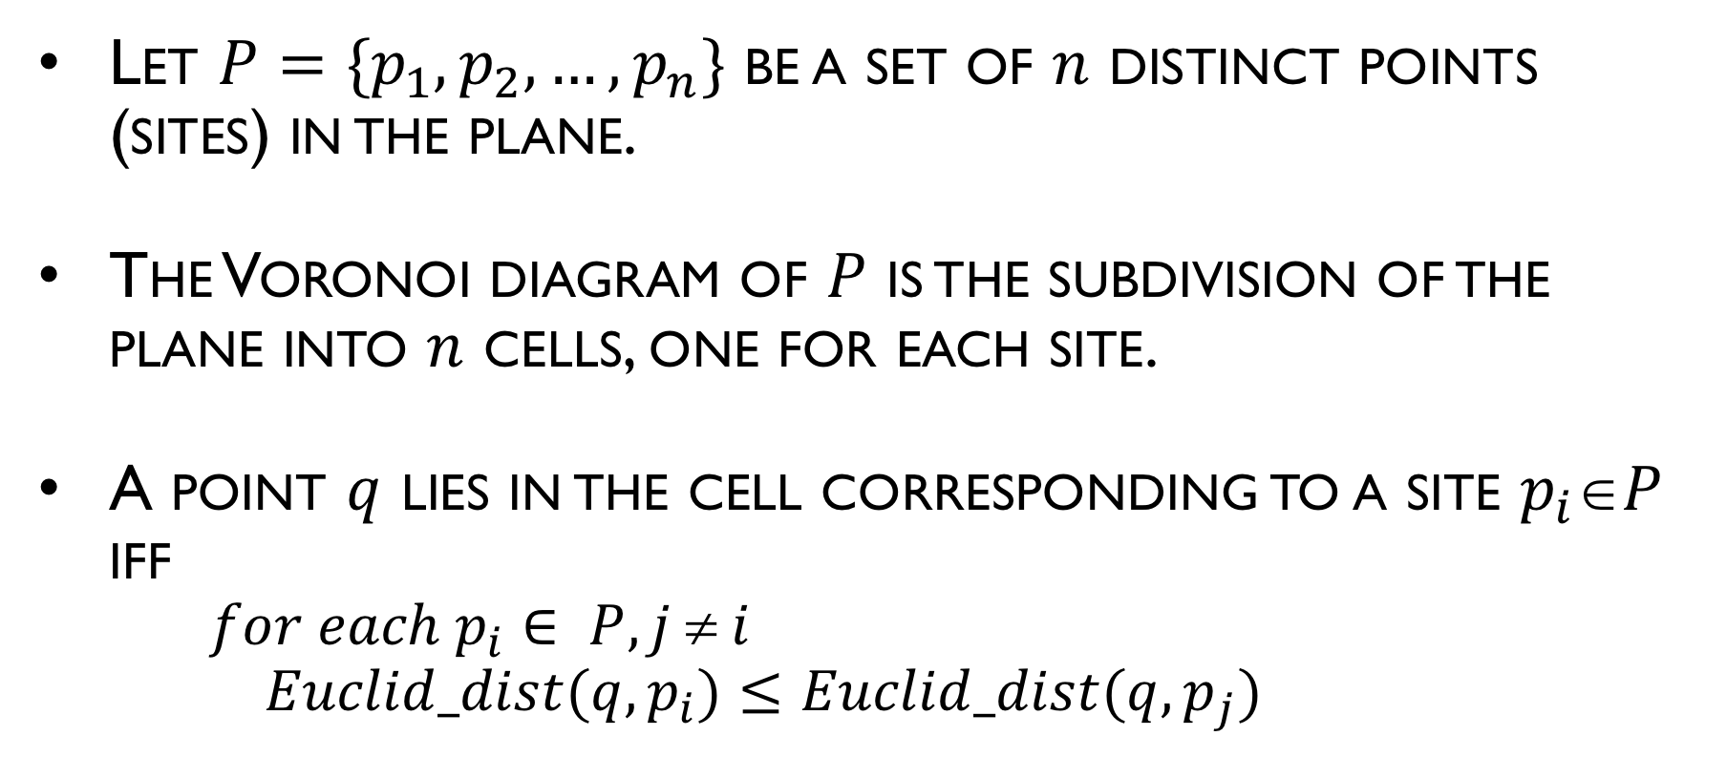
Definition of Voronoi Diagram
Let $P=\{p_{1},p_{2},…,p_{n}\}$ be a set of $n$ distinct points (sites) in the plane.
The Voronoi diagram of $P$ is the subdivision of the plane into $n$ cells, one for each site.
A point $q$ lies in the cell corresponding to a site $p_{i}P$ iff
$for each p_{i}∈ P, j  i$
$Euclid_dist(q,p_{i})≤Euclid_dist(q,p_{j})$

Slide 6
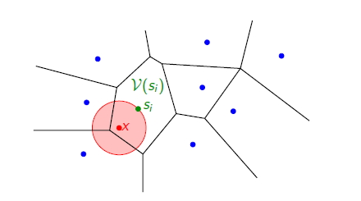
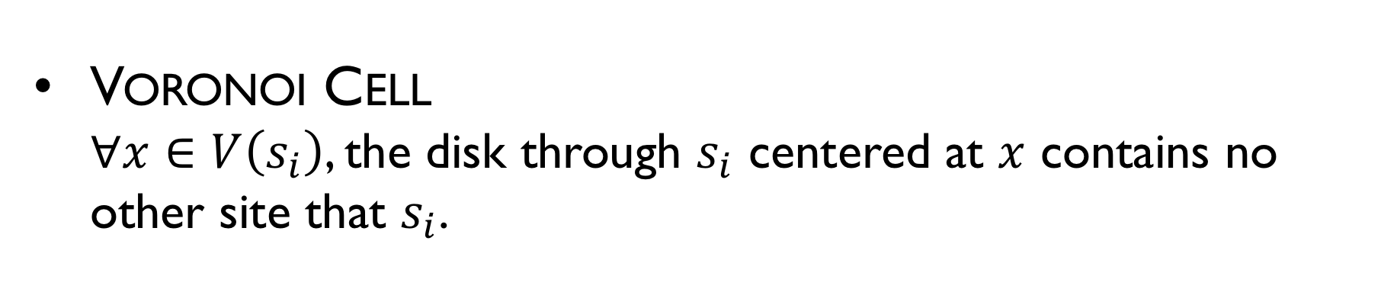
Properties
Voronoi Cell
$∀x∈V\left(s_{i}\right)$, the disk through $s_{i}$ centered at $x$ contains no other site that $s_{i}$.

Slide 7
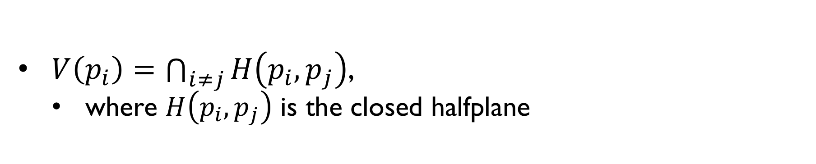
Definition of Voronoi Diagram
$V\left(p_{i}\right)=\bigcap_{i≠j}{H\left(p_{i},p_{j}\right)}$,
where $H\left(p_{i},p_{j}\right)$ is the closed halfplane

Slide 8
Two sites form a perpendicular bisector
Voronoi Diagram is a line that extends infinitely in both directions, and the two half planes on either side.

Slide 9
Two sites form a perpendicular bisector
Bisector is the collection of all circles whose perimeters touch both sites

Slide 10
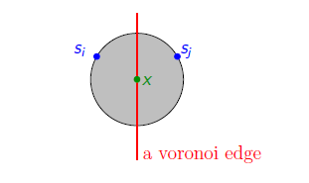
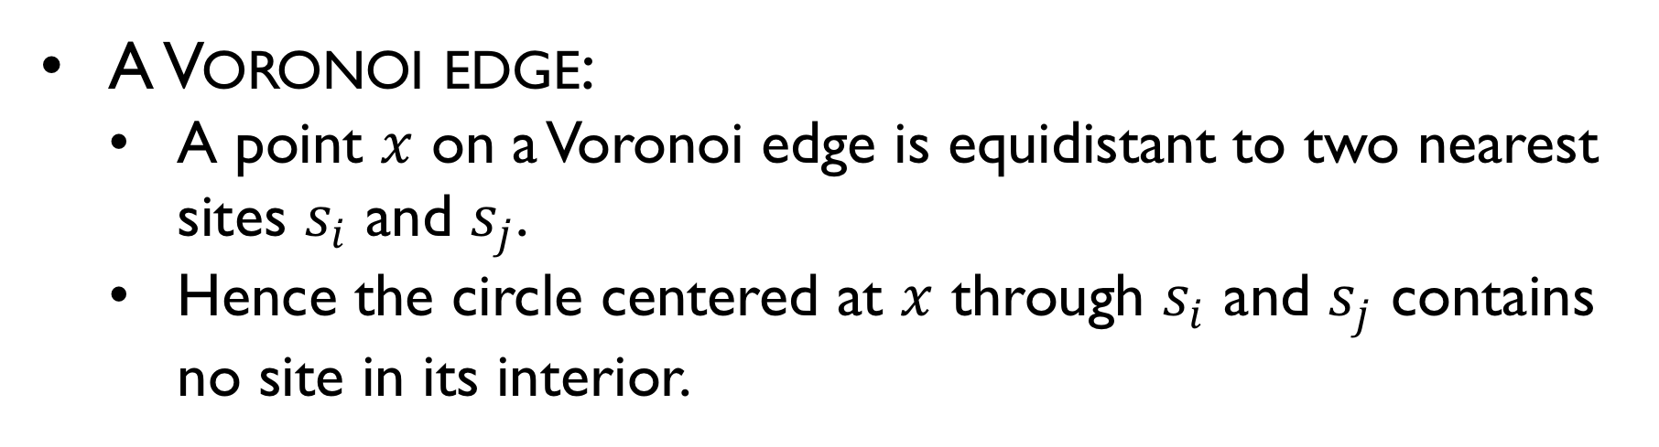
Properties
A Voronoi edge:
A point $x$ on a Voronoi edge is equidistant to two nearest sites $s_{i}$ and $s_{j}$.
Hence the circle centered at $x$ through $s_{i}$ and $s_{j}$ contains no site in its interior.

Slide 11
Collinear sites
Collinear sites form a series of parallel lines

Slide 12
Non-collinear sites form Voronoi half lines that meet at a vertex
A vertex has degree ≥ 3
v
A Voronoi vertex is the center of an empty circle touching 3 or more sites.
Half lines

Slide 13
Voronoi Cells and Segments
v
Segment
Bounded Cell
Unbounded Cell

Slide 14
2-D Voronoi diagrams
Which of the following is true for 2-D Voronoi diagrams?
Four or more non-collinear sites are…
sufficient to create a bounded cell
necessary to create a bounded cell
1 and 2
none of above
v

Slide 15
Degenerate Case: no bounded cells!
v

Slide 16
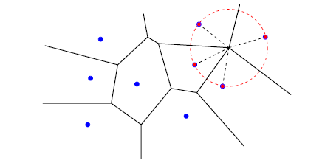
General Position Assumption
General position assumption: No four sites are co-circular.

Slide 17
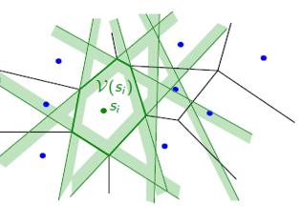
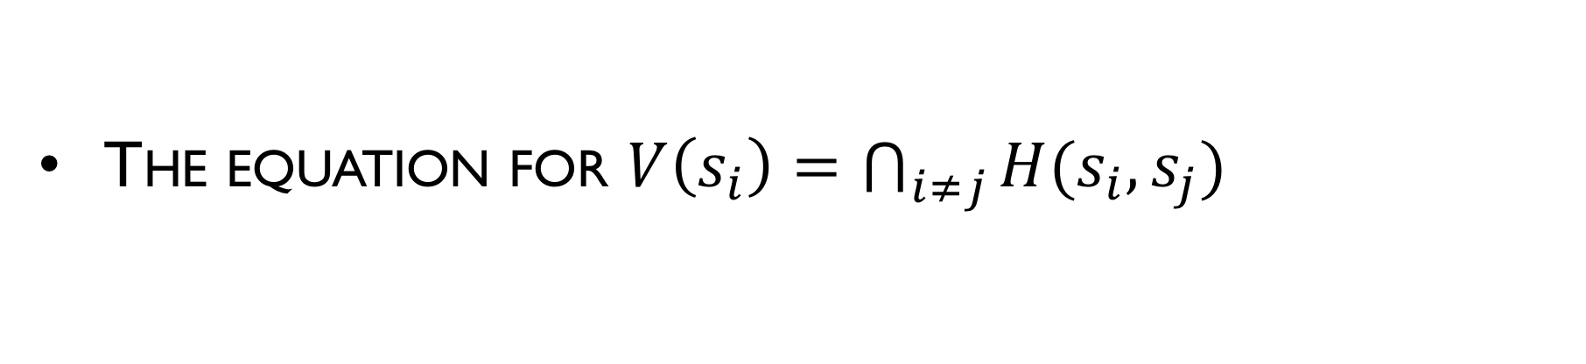
Naïve Algorithm: Intersection of Half-planes
The equation for $V\left(s_{i}\right)=\bigcap_{i≠j}{H(s_{i},s_{j})}$

Slide 18
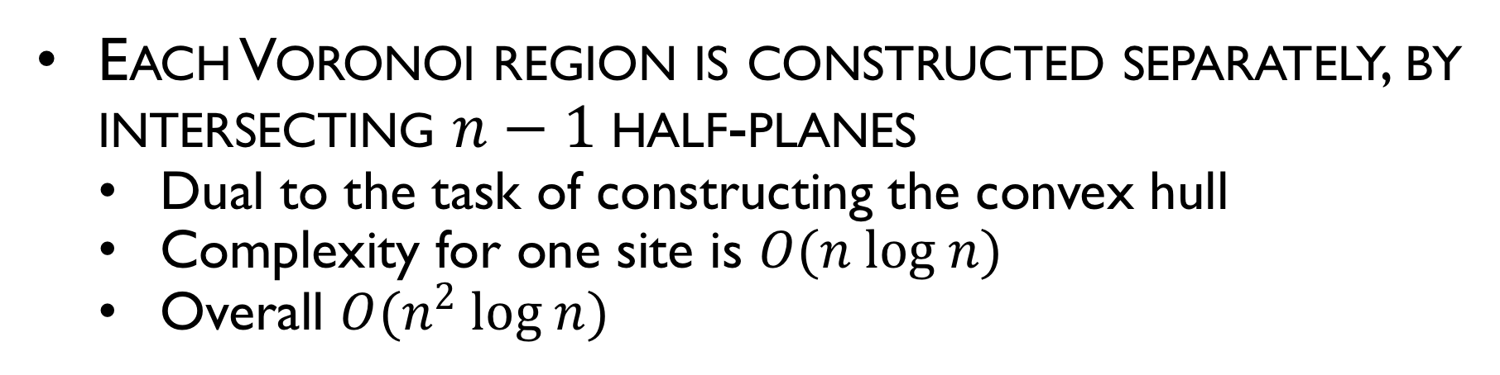
Naïve Algorithm: Intersection of Half-planes
Each Voronoi region is constructed separately, by intersecting $n−1$half-planes
Dual to the task of constructing the convex hull
Complexity for one site is $O(n log n)$
Overall $O(n^{2} log n)$

Slide 19
Voronoi Diagram
Construct Voronoi diagram for eight sites

Slide 20
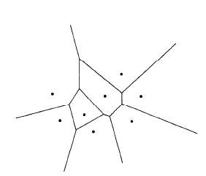
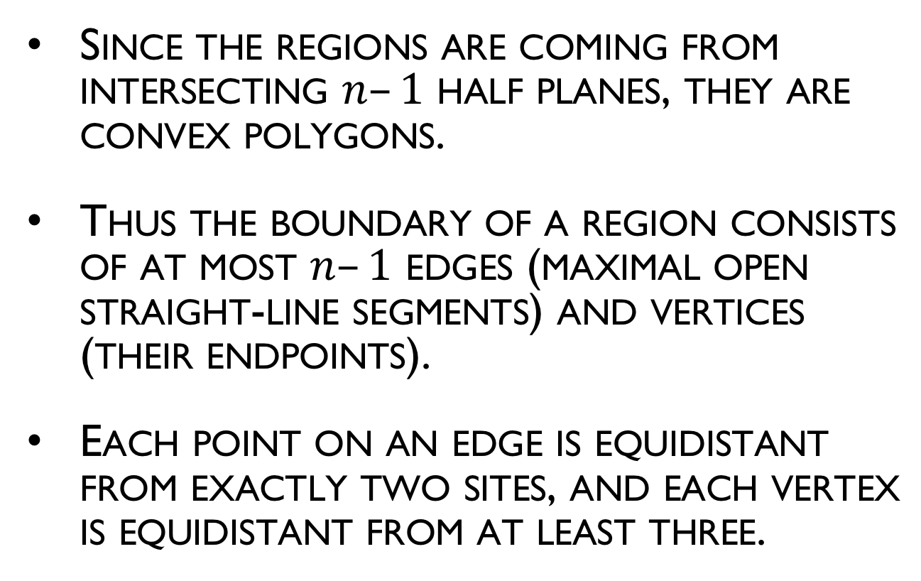
Voronoi Diagram Properties
Since the regions are coming from intersecting $n–1$ half planes, they are convex polygons.
Thus the boundary of a region consists of at most $n–1$ edges (maximal open straight-line segments) and vertices (their endpoints).
Each point on an edge is equidistant from exactly two sites, and each vertex is equidistant from at least three.

Slide 21
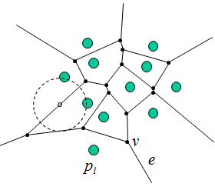
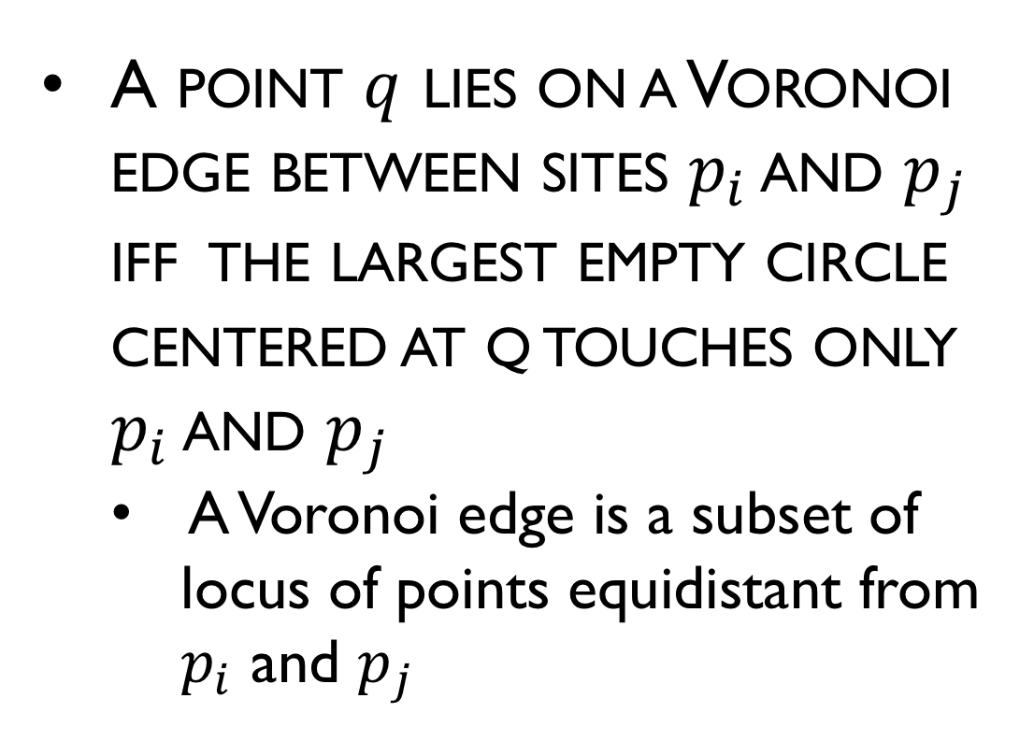
Voronoi Diagram Properties
A point $q$ lies on a Voronoi edge between sites $p_{i}$ and $p_{j}$ iff the largest empty circle centered at q touches only $p_{i}$ and $p_{j}$
A Voronoi edge is a subset of locus of points equidistant from $p_{i}$ and $p_{j}$
p_{i} : site points
e : Voronoi edge
v : Voronoi vertex

Slide 22
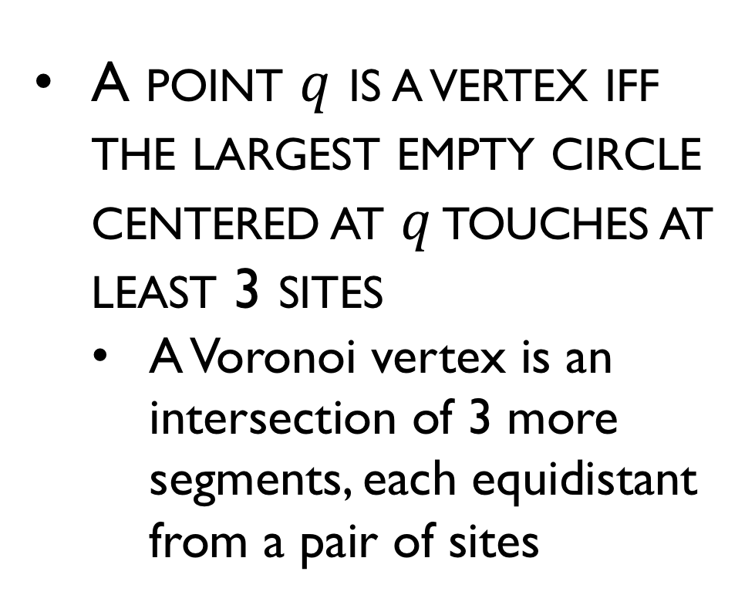
Voronoi Diagram Properties
A point $q$ is a vertex iff the largest empty circle centered at $q$ touches at least 3 sites
A Voronoi vertex is an intersection of 3 more segments, each equidistant from a pair of sites
p_{i} : site points
e : Voronoi edge
v : Voronoi vertex

Slide 23
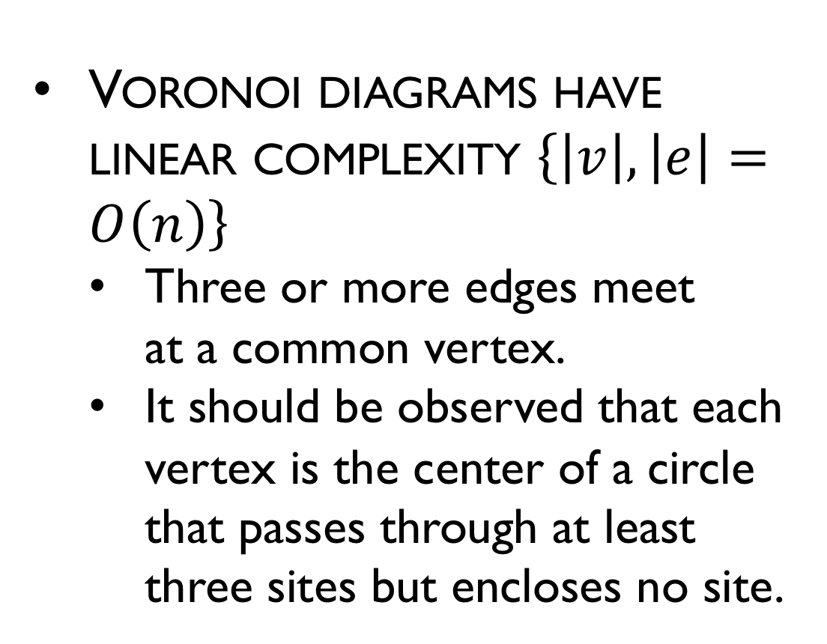
Complexity of Voronoi Diagram
Voronoi diagrams have linear complexity $\left\{\left|v\right|, \left|e\right|=O\left(n\right)\right\}$
Three or more edges meet at a common vertex.
It should be observed that each vertex is the center of a circle that passes through at least three sites but encloses no site.

Slide 24
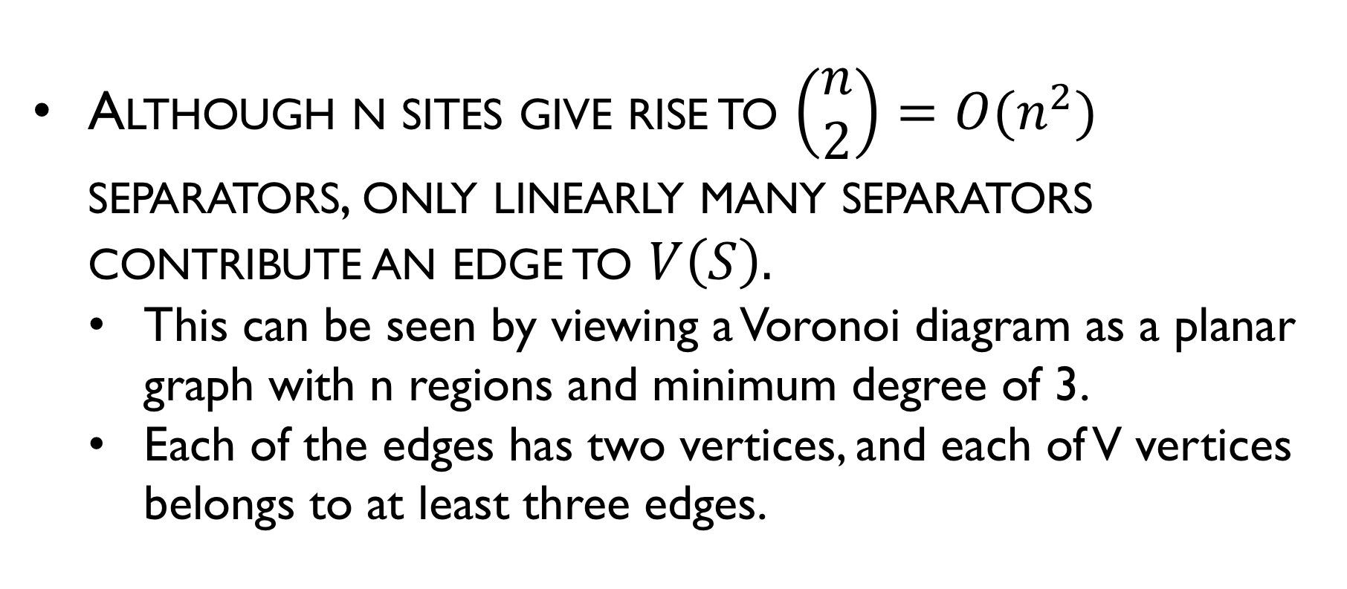
Complexity of Voronoi Diagram
Although n sites give rise to $\left(\begin{matrix}n \\ 2\end{matrix}\right)=O(n^{2})$ separators, only linearly many separators contribute an edge to $V\left(S\right).$
This can be seen by viewing a Voronoi diagram as a planar graph with n regions and minimum degree of 3.
Each of the edges has two vertices, and each of V vertices belongs to at least three edges.

Slide 25
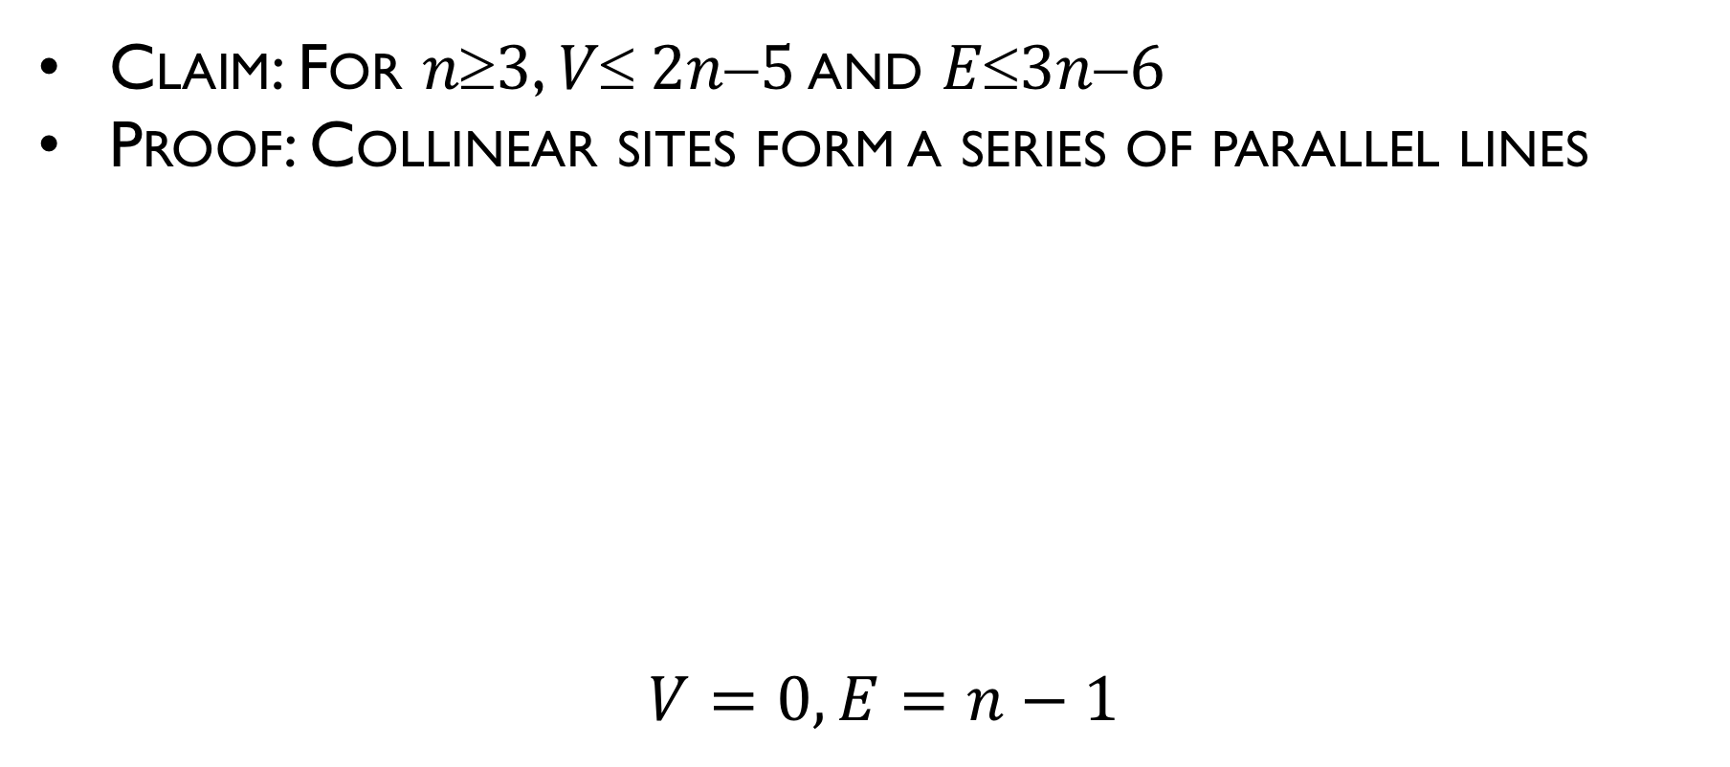
Complexity of Voronoi Diagram
Claim: For $n3$, $V 2n5$ and $E3n6$
Proof: Collinear sites form a series of parallel lines
$$V=0, E=n−1$$

Slide 26
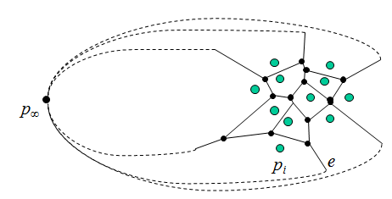
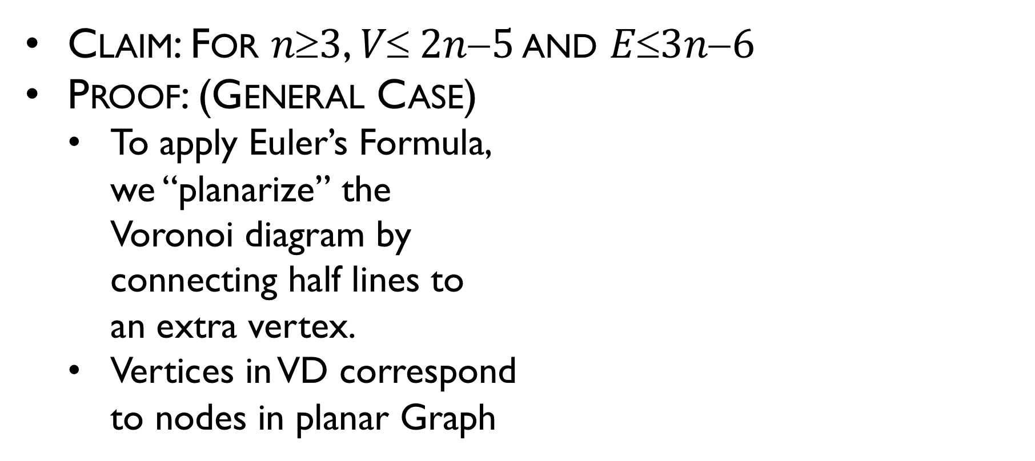
Complexity of Voronoi Diagram
Claim: For $n3$, $V 2n5$ and $E3n6$
Proof: (General Case)
To apply Euler’s Formula, we “planarize” the Voronoi diagram by connecting half lines to an extra vertex.
Vertices in VD correspond to nodes in planar Graph

Slide 27
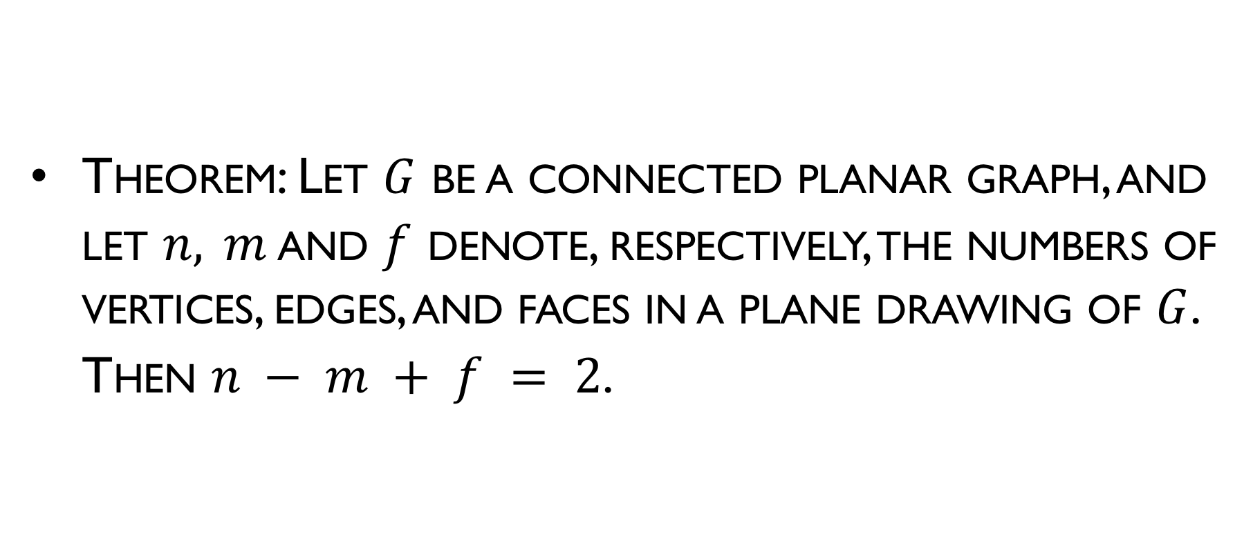
Euler's Formula
Theorem: Let $G$ be a connected planar graph, and let $n, m$ and $f$ denote, respectively, the numbers of vertices, edges, and faces in a plane drawing of $G$. Then $n − m + f = 2$.

Slide 28
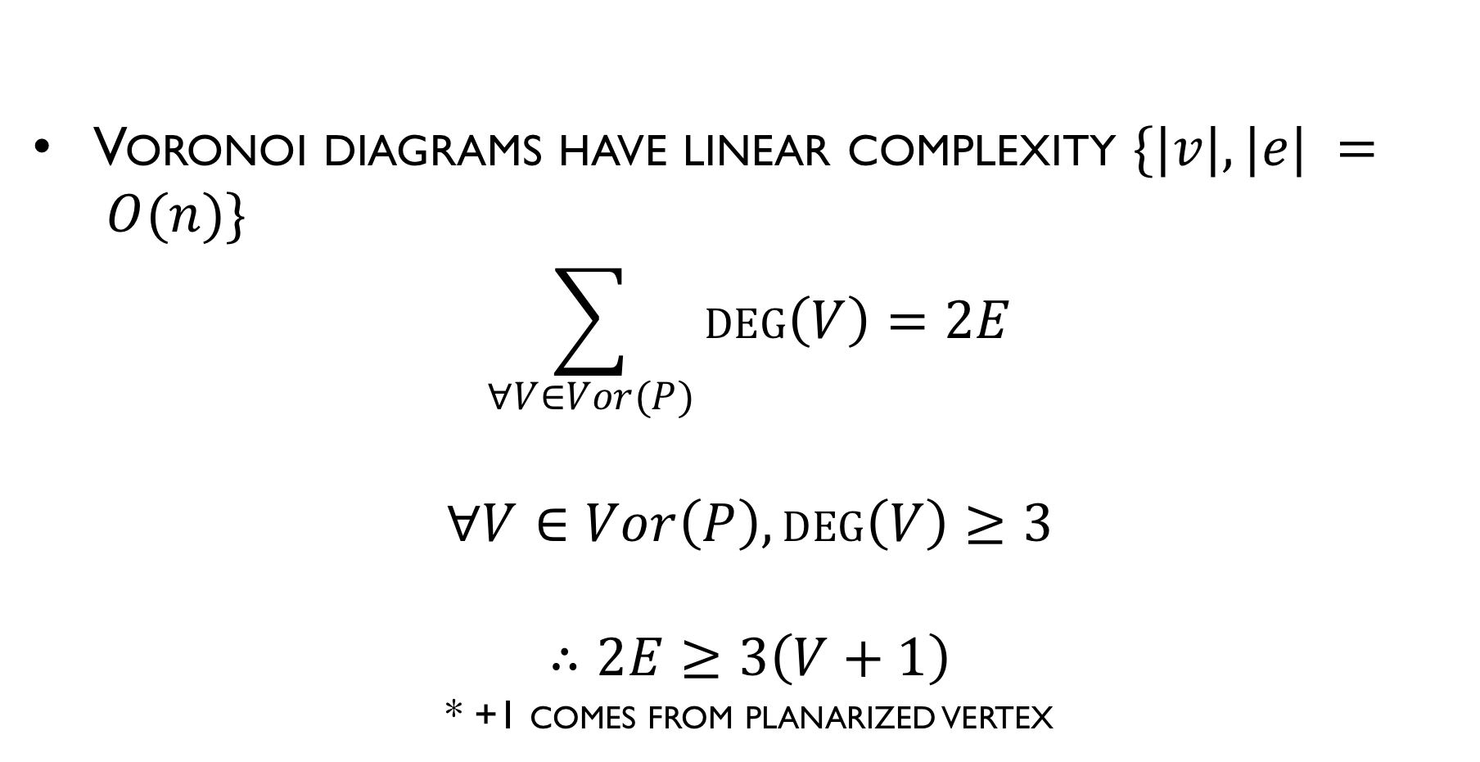
Complexity of Voronoi Diagram
Voronoi diagrams have linear complexity $\{|v|, |e| = O(n)\}$
$$\sum_{∀V∈Vor(P)}{\deg\left(V\right)=2E}$$
$$∀V∈Vor\left(P\right), deg\left(V\right)≥3$$
$$∴2E≥3\left(V+1\right)$$
* +1 comes from planarized vertex
Notes:
+1 for infinity

Slide 29
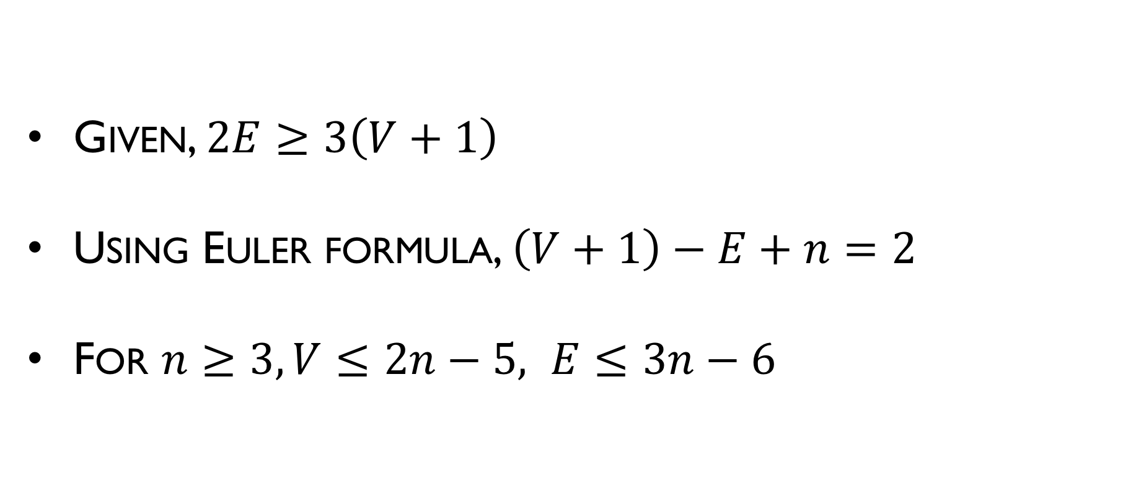
Complexity of Voronoi Diagram
Given, $2E≥3\left(V+1\right)$
Using Euler formula, $\left(V+1\right)−E+n=2$
For $n≥3, V≤2n−5, E≤3n−6$

Slide 30
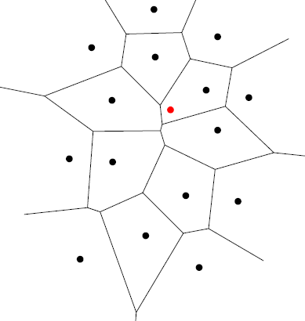
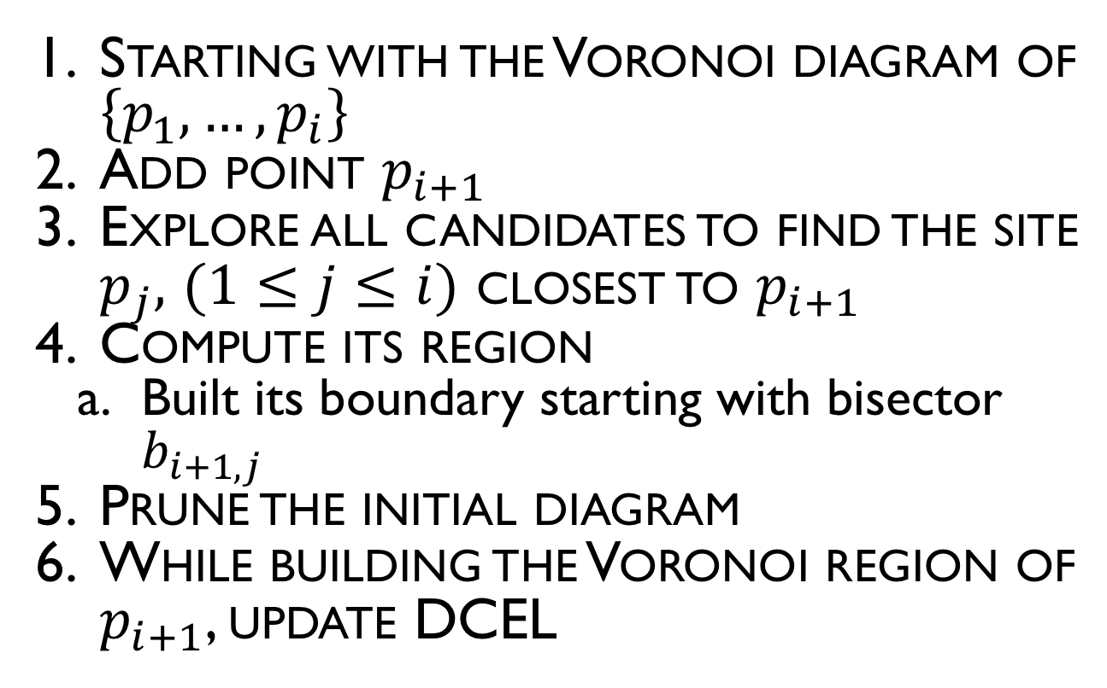
Incremental algorithm
Starting with the Voronoi diagram of $\left\{p_{1},…,p_{i}\right\}$
Add point $p_{i+1}$
Explore all candidates to find the site $p_{j},$ $(1≤j≤i)$ closest to $p_{i+1}$
Compute its region
Built its boundary starting with bisector $b_{i+1,j}$
Prune the initial diagram
While building the Voronoi region of $p_{i+1}$, update DCEL

Slide 31
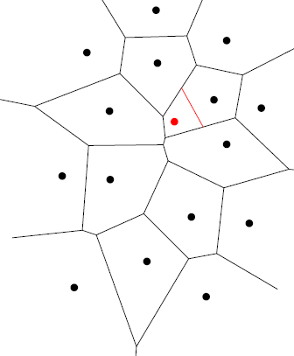
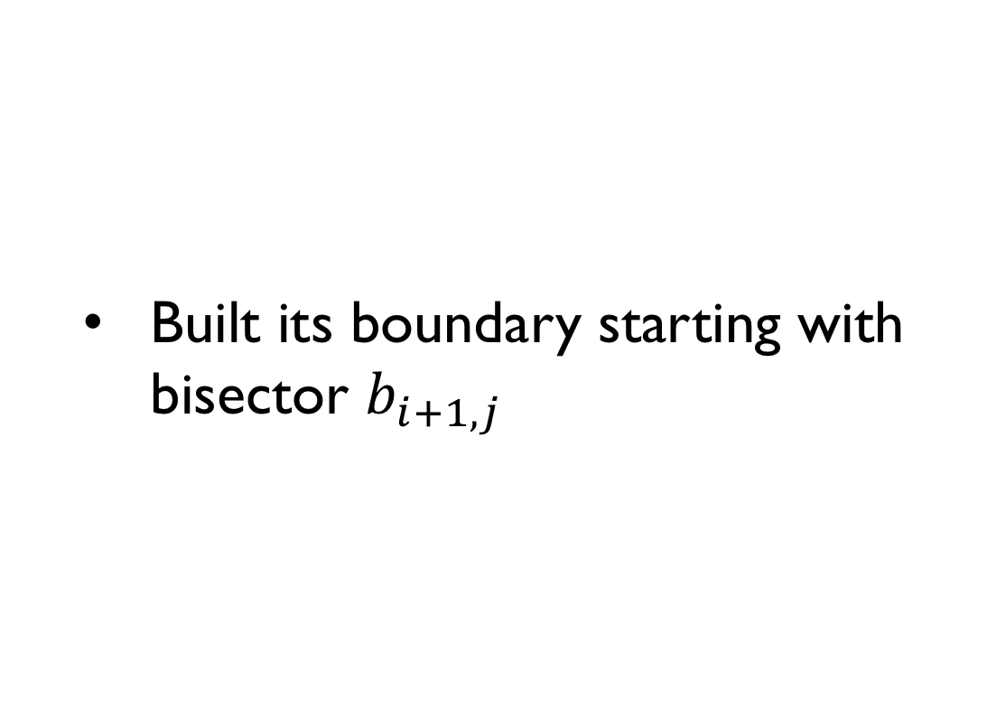
Incremental algorithm
Built its boundary starting with bisector $b_{i+1,j}$

Slide 32
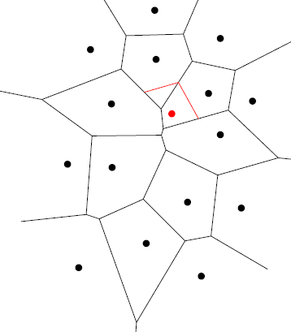
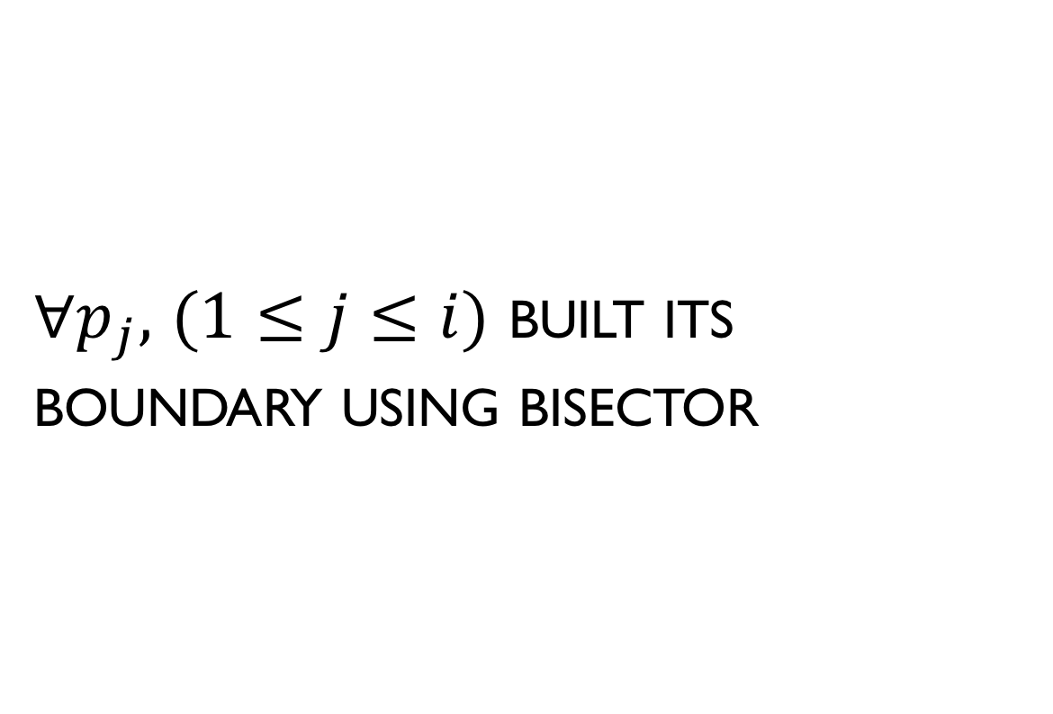
Incremental algorithm
$∀p_{j},$ $(1≤j≤i)$ built its boundary using bisector

Slide 33
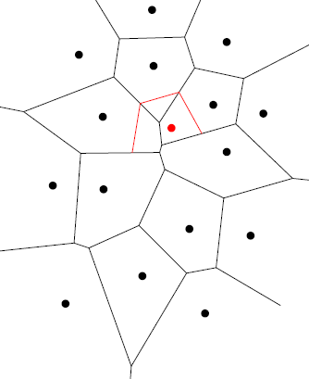
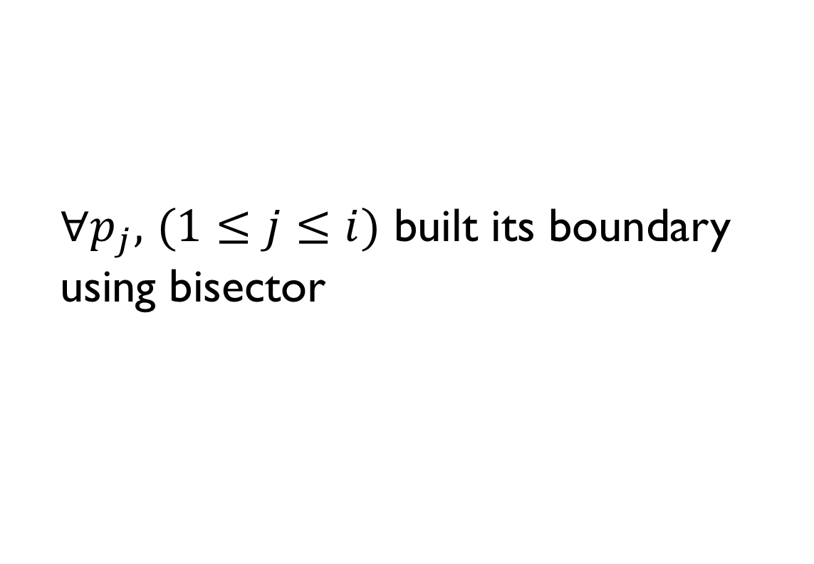
Incremental algorithm
$∀p_{j},$ $(1≤j≤i)$ built its boundary using bisector

Slide 34
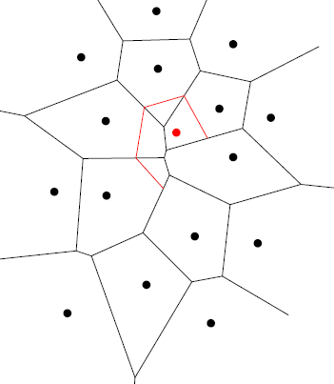
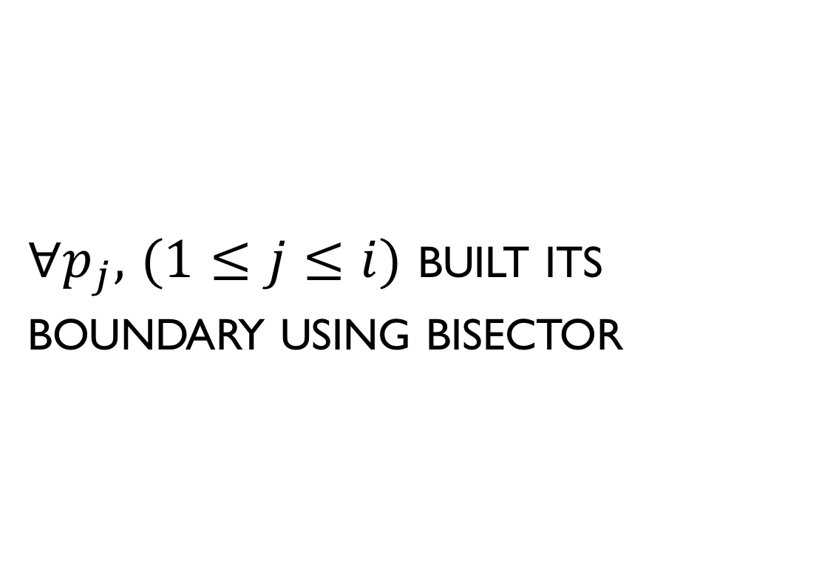
Incremental algorithm
$∀p_{j},$ $(1≤j≤i)$ built its boundary using bisector

Slide 35
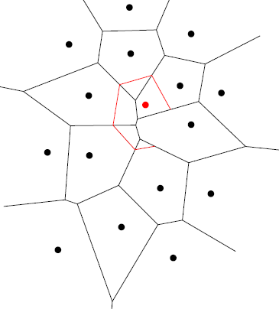
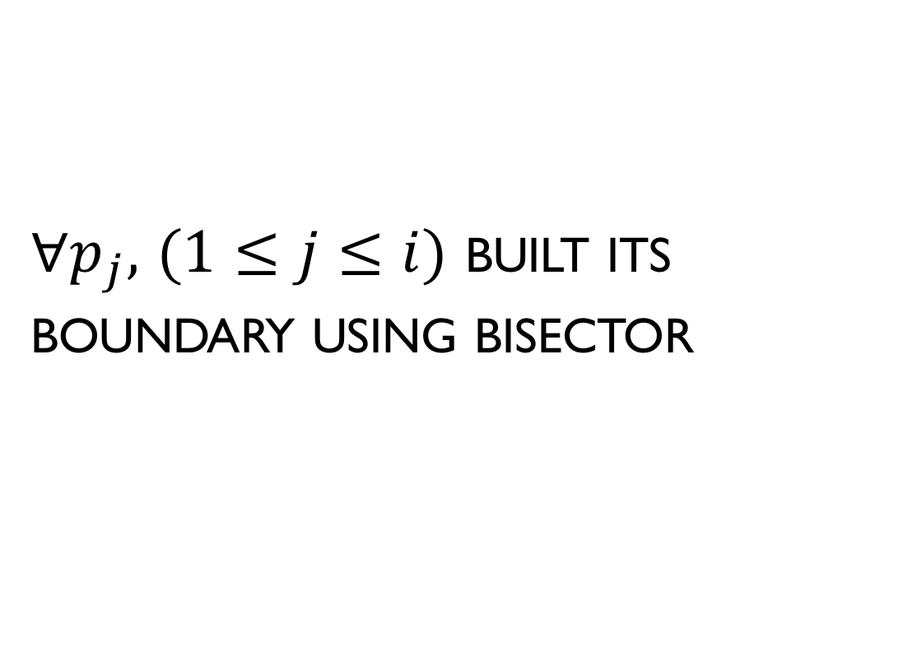
Incremental algorithm
$∀p_{j},$ $(1≤j≤i)$ built its boundary using bisector

Slide 36
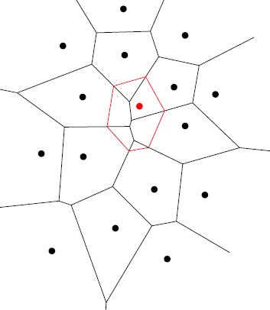
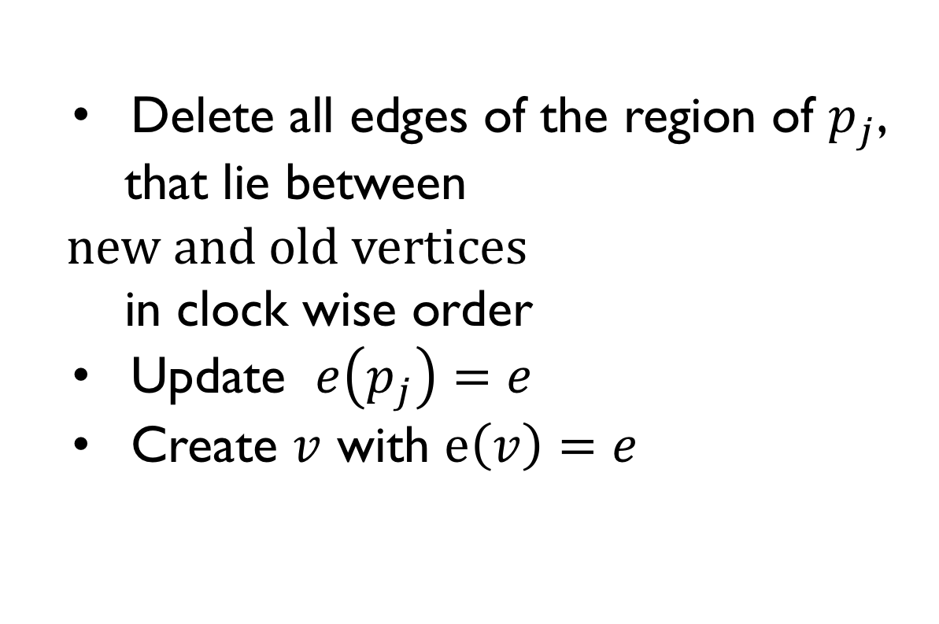
Incremental algorithm
Delete all edges of the region of $p_{j}$,
that lie between $new and old vertices$
in clock wise order
Update $e\left(p_{j}\right)=e$
Create $v$ with $e\left(v\right)=e$

Slide 37
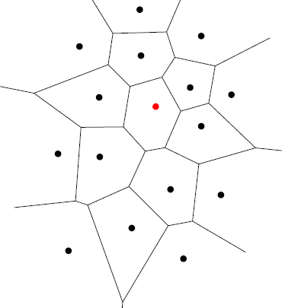
Incremental algorithm
Prune the initial diagram

Slide 38
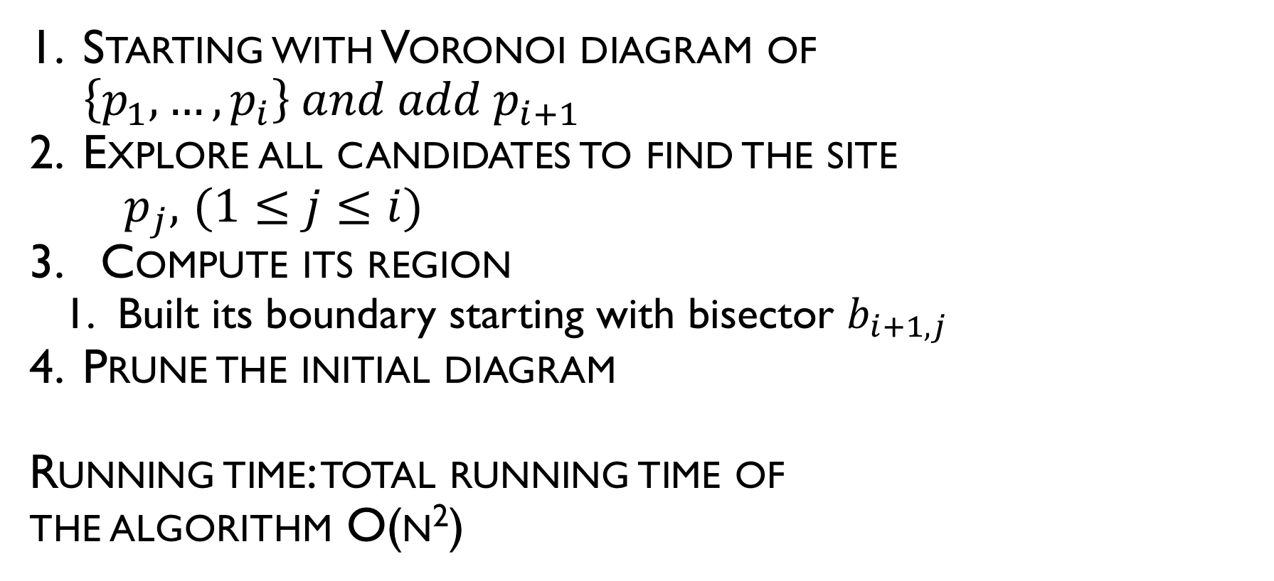
Incremental algorithm
Starting with Voronoi diagram of $\left\{p_{1},…,p_{i}\right\} and add p_{i+1}$
Explore all candidates to find the site
$p_{j},$ $(1≤j≤i)$
3. Compute its region
Built its boundary starting with bisector $b_{i+1,j}$
Prune the initial diagram
Running time: total running time of
the algorithm O(n²)

Slide 39
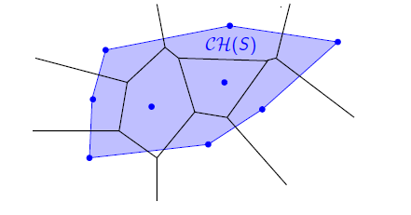
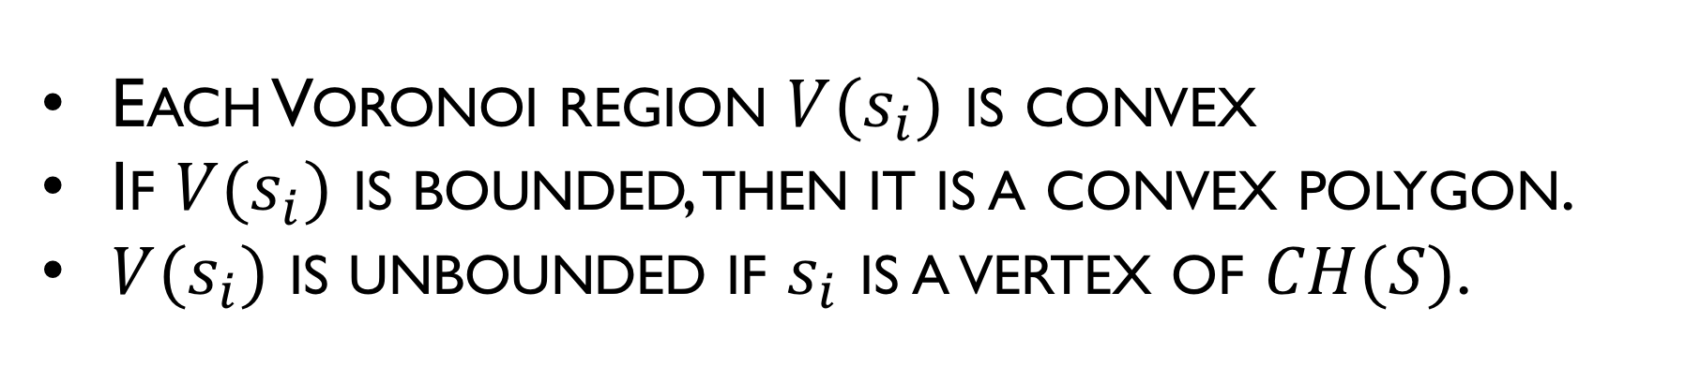
Voronoi Cells
Each Voronoi region $V(s_{i})$ is convex
If $V(s_{i})$ is bounded, then it is a convex polygon.
$V(s_{i})$ is unbounded if $s_{i}$ is a vertex of $CH(S)$.

Slide 40
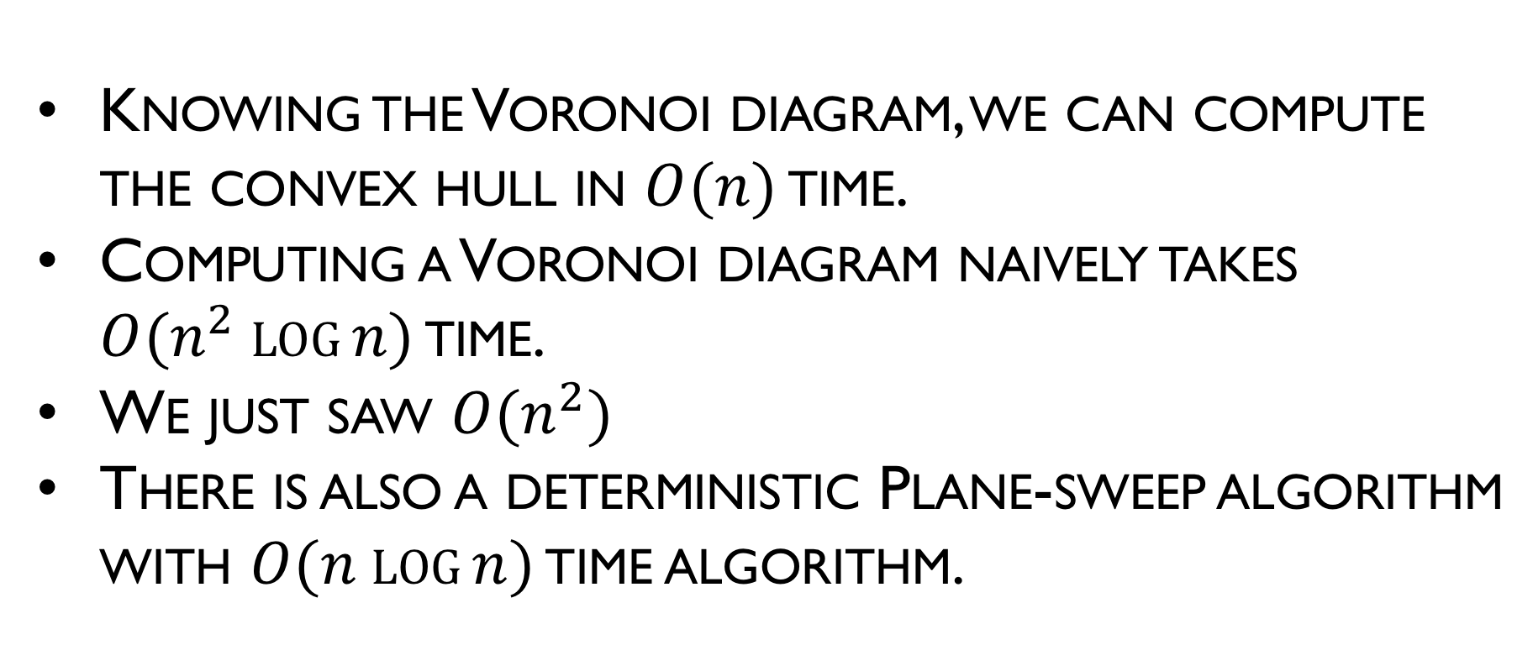
Consequence
Knowing the Voronoi diagram, we can compute the convex hull in $O(n)$ time.
Computing a Voronoi diagram naively takes $O(n^{2} log⁡n)$ time.
We just saw $O(n^{2})$
There is also a deterministic Plane-sweep algorithm with $O(n log⁡n)$ time algorithm.

Slide 41
Divide and Conquer Algorithm
Sort the points of P by x-coordinate and vertically partition into two subsets R and L, of approximately the same size
Recursively compute V(R) and V(L)
Compute the separation chain
Prune the portion of V(R) lying to the left of the chain and the portion of V(L) to its right
The total running time of the algorithm is $O(nlogn)$
This running time is optimal

Slide 42
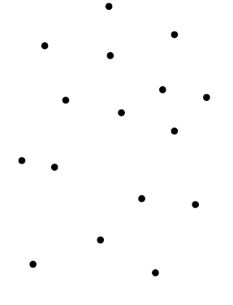
Divide and Conquer
Let P be a set of n points in plane

Slide 43
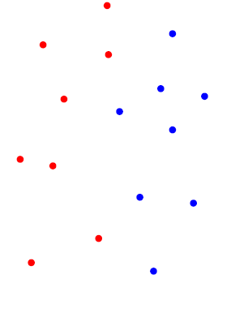
Divide and Conquer
Sort the points of P abscissa and vertically partition P into two subsets R and L, of approximately the same size

Slide 44
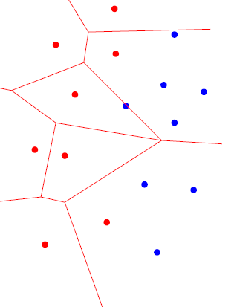
Divide and Conquer
2. Recursively compute V(L)

Slide 45
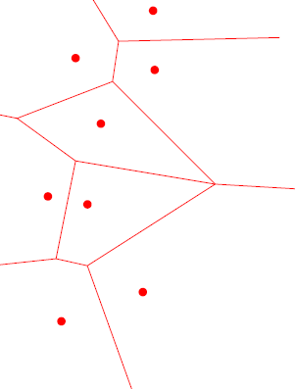
Divide and Conquer
Consider the Voronoi diagram of L

Slide 46
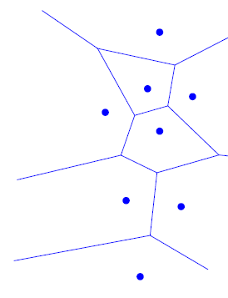
Divide and Conquer
Recursively compute V(R)
Consider the Voronoi diagram of R

Slide 47
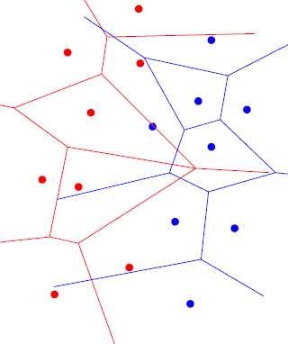
Divide and Conquer
Combine two diagrams
Then Voronoi diagram of P substantially coincides with the Voronoi diagram of R and L

Slide 48

Divide and Conquer
there exists a chain of edges of V such that V coincides with V (R) to the right of the chain, and it coincides with V(L) to its left

Slide 49


Divide and Conquer
Definition: Let b(R,L) be the set of all edges and vertices of V (P) belonging to common boundary of the regions of some $p_{i}∈R and p_{j}∈L.$
Observation: The bisector b(R,L) is y-monotone chain leaving the regions of the points $p_{i}∈R$to its right and those of $p_{j}∈L$ to its left

Slide 50

Divide and Conquer Algorithm
Compute the separating chain

Slide 51

Divide and Conquer
Prune the portion of V(R) lying to the right of the chain and the portion of V(L) lying to its left

Slide 52
Divide and Conquer
How to compute the chain?

Slide 53

Divide and Conquer
Initialization: Find the two half-lines

Slide 54

Divide and Conquer
Find the convex hull for V(L)

Slide 55

Divide and Conquer
Find the convex hull for V(R)

Slide 56

Divide and Conquer
Find two highest and two lowest points

Slide 57

Divide and Conquer
We will connect the two highest points and the two lowest points

Slide 58


Divide and Conquer
Advance: Starting with one of the half-lines, and until getting to the other one
Each time an edge $e∈b\left(R,L\right)$ begins, such that $e∈b_{ij}$, $p_{i}∈R and p_{j}∈L, do$:

Slide 59


Divide and Conquer
Detect intersection with $L\left(p_{j}\right)$ or $R(p_{i})$

Slide 60

Divide and Conquer
Chose the first of the two intersection points

Slide 61


Divide and Conquer
Detect the site $p_{k}$ corresponding to the new starting region
Replace $p_{i}$ or $p_{j}$by $p_{k}$

Slide 62

Divide and Conquer
Restart with the new edge

Slide 63

Divide and Conquer
Continue the process

Slide 64

Divide and Conquer
Continue

Slide 65

Divide and Conquer
Restart with the new edge

Slide 66

Divide and Conquer
Restart with the new edge

Slide 67

Divide and Conquer
Restart with the new edge

Slide 68


Divide and Conquer
Detect the site $p_{k}$ corresponding to the new starting region
Replace $p_{i}$ or $p_{j}$by $p_{k}$
Restart with the new edge

Slide 69


Divide and Conquer
Replace $p_{i}$ or $p_{j}$by $p_{k}$
Restart with the new edge

Slide 70

Divide and Conquer
Replace $p_{i}$ or $p_{j}$by $p_{k}$
Restart with the new edge

Slide 71


Algorithm of constructing the monotone chain
Advance: Starting with one of the half-lines, and until getting to the other one, do:
Each time an edge $e∈b\left(R,L\right)$ begins, such that $e∈b_{ij}$, $p_{i}∈R and p_{j}∈L, do$:
Detect intersection with V or $R(p_{i})$
Detect intersection with V or $L(p_{j})$
Chose the first of the two intersection points
Detect the site $p_{k}$ corresponding to the new starting region
Replace $p_{i}$ or $p_{j}$by $p_{k}$
Restart with the new edge

Slide 72
Divide and Conquer
Performance Analysis?

Slide 73

Fortune’s algorithm
Fortune's algorithm is a sweep line algorithm for generating a Voronoi diagram from a set of points in a plane using $O(n log⁡n)$time and $O(n)$ space
The strategy in a plane sweep algorithm is to sweep a horizontal line (sweep line) (L) from top to bottom
Information maintained about the part of the Voronoi diagram of the sites above L that cannot be changed by sites below L

Slide 74
Fortune’s Algorithm
The algorithm maintains both a sweep line and a beach line, which both move through the plane as the algorithm progresses.
Horizontal sweep line maintains order of construction
Beach line maintains portion of diagram, which cannot change due to sites below sweep line

Slide 75




Fortune’s algorithm
$$+z$$
Consider two nearby cones
If cones over all sites are opaque, and they are viewed from $z→−∞$, what is seen is precisely the Voronoi diagram
$$-z$$

Slide 76


Fortune’s algorithm
Fortune’s idea: Sweep the cones with a plane $π$, slanted at ${45}^{°}$ to the xy-plane

Slide 77
Beach line
Which points are closer to a site above the sweep line than to the sweep line itself?
The set of parabolic arcs form a beach-line that bounds the locus of all such points
The beach line is monotone
Beach line
Equidistant
Sweep line

Slide 78

Edges
Breakpoints trace out Voronoi edges.
The only way in which a new arc can appear on the beach line is through a site event

Slide 79

Edges
Arcs flatten out as sweep line moves down.

Slide 80

Edges
Eventually, the middle arc disappears.
The only way in which an existing arc can disappear from the beach line is through a circle event

Slide 81

Circle Event
We have detected a circle that is empty (contains no sites) and touches 3 or more sites.

Slide 82

Circle Event
We have detected a circle that is empty (contains no sites) and touches 3 or more sites when the sweep line passes the lowest point in the circle.

Slide 83
Beach Line Properties
Voronoi edges are traced by the break points as the sweep line moves down.
Emergence of a new break point(s) (from formation of a new arc or a fusion of two existing break points) identifies a new edge
Voronoi vertices are identified when two break points meet (fuse).
Decimation of an old arc identifies new vertex

Slide 84
Data Structures
Current state of the Voronoi diagram
Doubly-linked list
The beach line is represented by a balanced binary search tree
The event queue is implemented as priority queue
Priority event queue sorted on decreasing y-coordinate

Slide 85

Doubly Linked List (D)
Goal: a simple data structure that allows an algorithm to traverse a Voronoi diagram’s segments, cells and vertices

Slide 86

Doubly Linked List (D)
Divide segments into unidirectional half-edges
A chain of counter-clockwise half-edges forms a cell
Define a half-edge’s “twin” to be its opposite half-edge of the same segment

Slide 87

Balanced Binary Tree
A balanced binary search tree is used to maintain the status of the beach line.
Internal nodes represent break points between two arcs
Also contains a pointer to the D record of the edge being traced
Leaf nodes represent arcs, each arc is in turn represented by the site that generated it
Also contains a pointer to a potential circle event

Slide 88
Event Queue (Q)
An event is an interesting point encountered by the sweep line that makes discrete stops at events as it sweeps from top to bottom
Consists of:
Site Events – when the sweep line encounters a new site point
Circle Events – when the sweep line encounters the bottom of an empty circle touching 3 or more sites
Events are prioritized based on y-coordinate

Slide 89

Site Event
A new arc appears when a new site appears.

Slide 90

Site Event
Original arc above the new site is broken into two arcs
Number of arcs on beach line is O(n)

Slide 91
Site Event
Effects on Binary Tree
P1
E1
E1
E1
E2
P2
P2
P1
P2
E2
E3
P1
P3
P3

Slide 92

Circle Event
An arc disappears whenever an empty circle touches three or more sites and is tangent to the circle.
Sweep line helps determine that the circle is indeed empty.

Slide 93
Circle Event
Effects on Binary Tree
Other circle events will remove nodes from the tree
P1
E1
E1
E3
P2
E2
P2
E2
P2
E2
E3
P1
P3
P1
P3
P3

Slide 94
Event Queue Summary
Site Events are
given as input
represented by the (x,y)-coordinate of the site point
Circle Events are
represented by the (x,y)-coordinate of the lowest point of an empty circle touching three or more sites
computed on the fly (intersection of the two bisectors in between the three sites)
“anticipated”: these newly generated events may represented by the (x,y)-coordinate of the lowest point of an empty circle touching three or more sites; they can be false and need to be removed later
Event Queue prioritizes events based on their y-coordinates

Slide 95
Example

Slide 96
Summarizing Data Structures
Current state of the Voronoi diagram
Doubly linked list of half-edges, vertices, cell records
Current state of the beach line
Keep track of break points
Inner nodes of binary search tree; represented by a tuple
Keep track of arcs currently on beach line
Leaf nodes of binary search tree; represented by a site that generated the arc
Current state of the sweep line
Priority event queue sorted on decreasing y-coordinate

Slide 97
Degenerate Cases
Events in Q share the same y-coordinate
Can additionally sort them using x-coordinate
Circle event involving more than 3 sites
Current algorithm produces multiple degree 3 Voronoi vertices joined by zero-length edges
Can be fixed in post processing

Slide 98
Degenerate Cases
Site points are collinear (break points neither converge or diverge)
Bounding box takes care of this
One of the sites coincides with the lowest point of the circle event
Do nothing

Slide 99
Handling Site Events
Locate the leaf representing the existing arc that is above the new site
Delete the potential circle event in the event queue
Break the arc by replacing the leaf node with a sub tree representing the new arc and break points
Add a new edge record in the link list
Check for potential circle event(s), add them to queue if they exist
Store in the corresponding leaf of T a pointer to the new circle event in the queue
O(N log N)
O(1)
O(1)
O(1)

Slide 100
Handling Circle Events
Delete from T the leaf node of the disappearing arc and its associated circle events in the event queue
Add vertex record in doubly link list
Create new edge record in doubly link list
Check the new triplets formed by the former neighboring arcs form potential circle events
O(N log N)
O(1)
O(1)
O(1)

Slide 101
Total Running Time
Each new site can generate at most two new arcs beach line can have at most 2n – 1 arcs
Each “false circle event” can be changed to a real event O(n) events
Site/Circle Event Handler O(log n)
O(n log n) total running time

